Slide 1
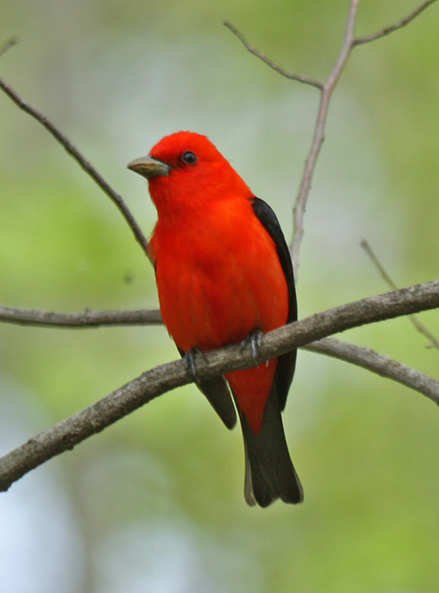
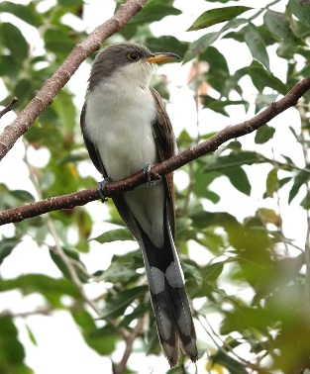
Bird-habitat associations in south-central Iowa
Benjamin M. West and Stephen J. Dinsmore
Benjamin M. West

Slide 2
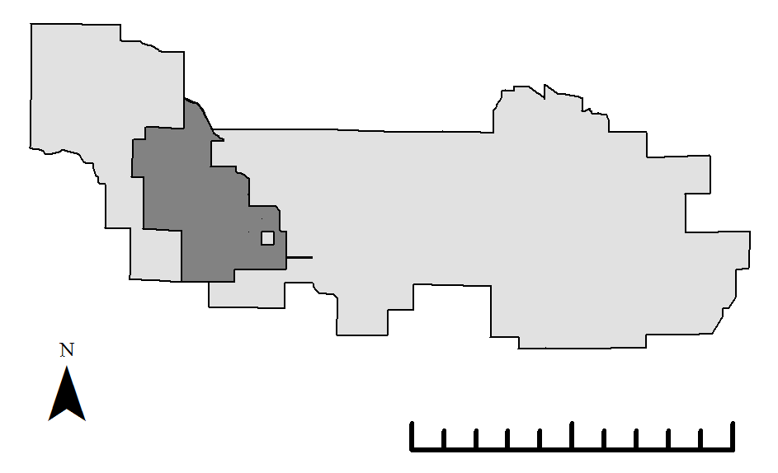
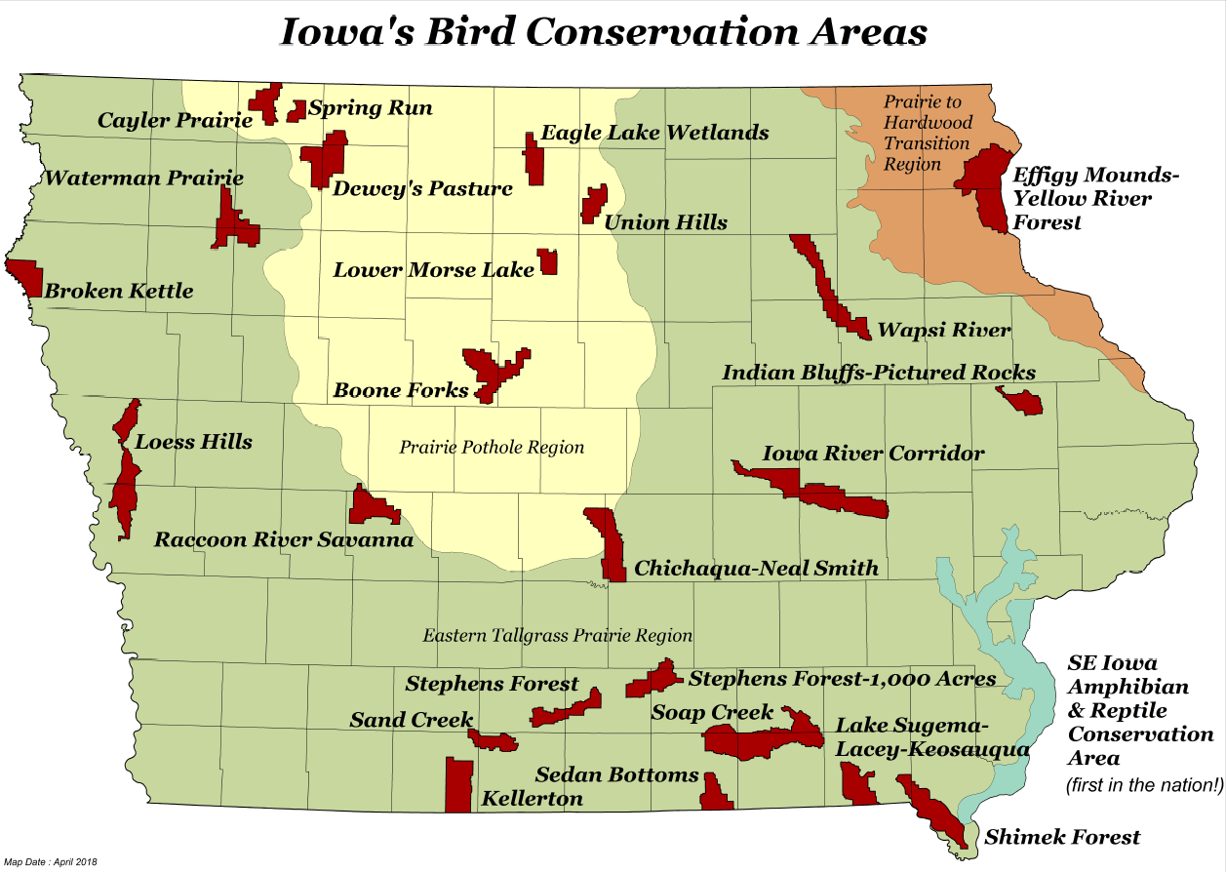
Background: Bird Conservation Areas
Protected core habitat
Private/public land with some habitat
0
5
10 km

Slide 3
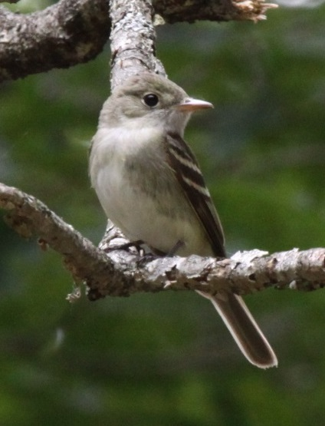
Objectives
Acadian Flycatcher
Iowa Wildlife Action Plan
Species of Greatest Conservation Need (SGCN)
Conservation priority
Study Objectives:
Which SGCNs occur in the focal BCAs?
How do SGCN densities relate to habitat characteristics?

Slide 4
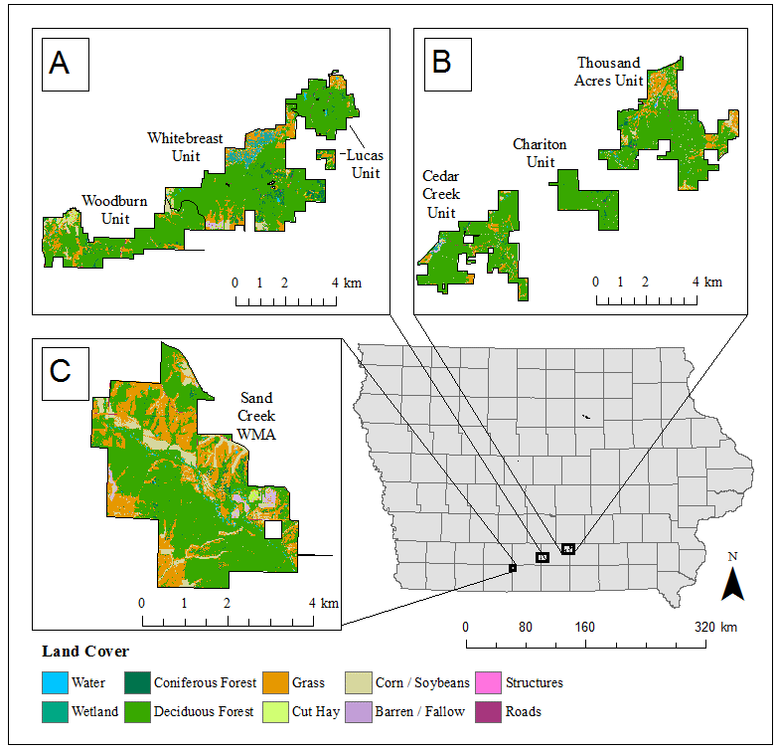
Study Area
Stephens Forest BCA
Thousand Acres BCA
Sand Creek
BCA

Slide 5
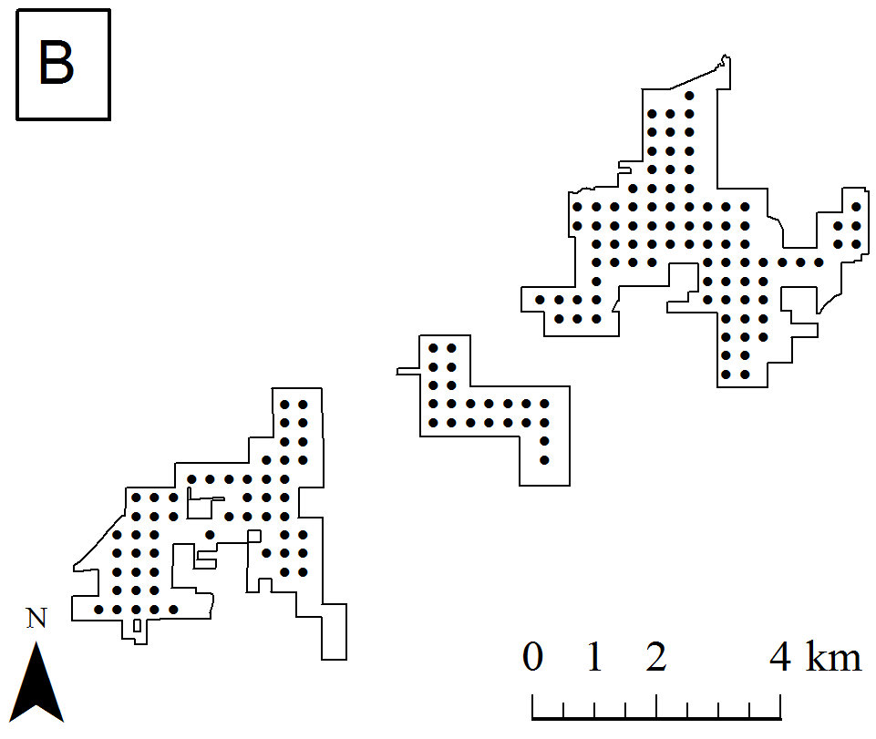
Bird Point Counts
Thousand Acres BCA
493 points
2016-2019
Two visits/year
Distance sampling
4 bins
100 m truncation
10 minutes
No visual only or known female observations

Slide 6
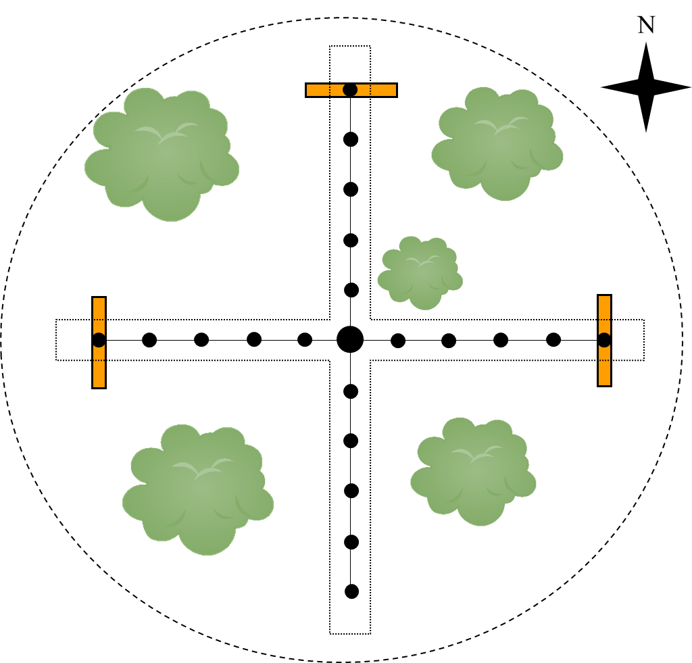
Vegetation Surveys
493 points (same as bird surveys)
July – August 2019
Forestry prism sample, ground cover, shrub stems
Canopy closure not used, midstory metrics coming later

Slide 7
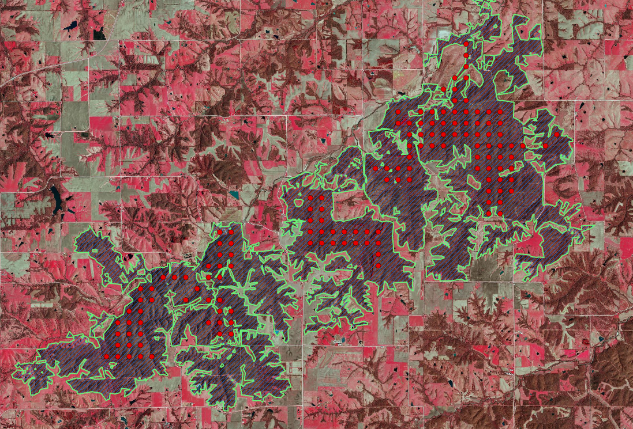
Landscape Scale Data
Cropscape data and ArcGIS used to estimate % forest cover within 1 and 10 km of point
Digitized 2016-2018 Iowa Spring Color Infrared Orthophotos to get forest patch boundaries (Cropscape as an initial template)

Slide 8
Data Analysis
Estimate detection probability to get more accurate estimates of density
Generalized distance sampling (GDS) in R package ‘unmarked’
Detection covariates:
Time since sunrise
Julian day
Observer
Wind speed
AIC model selection

Slide 9
Habitat Hierarchy for GDS Density
YEAR EFFECTS
-Species richness
-Total live tree basal area
-Total dead tree basal area
-Proportion of basal that is oak (proportion oak)
Year (catergorical)
TREE CHARACTERISTICS
-Size of nearest forest patch
-Proportion forest in 1 km radius
-Proportion forest in 10 km radius
LANDSCAPE SCALE
-Shrub stem density
-% grass cover
-% leaf litter cover
-% “green” ground cover
AT OR NEAR GROUND LEVEL
EDGE EFFECTS
Distance to edge

Slide 10
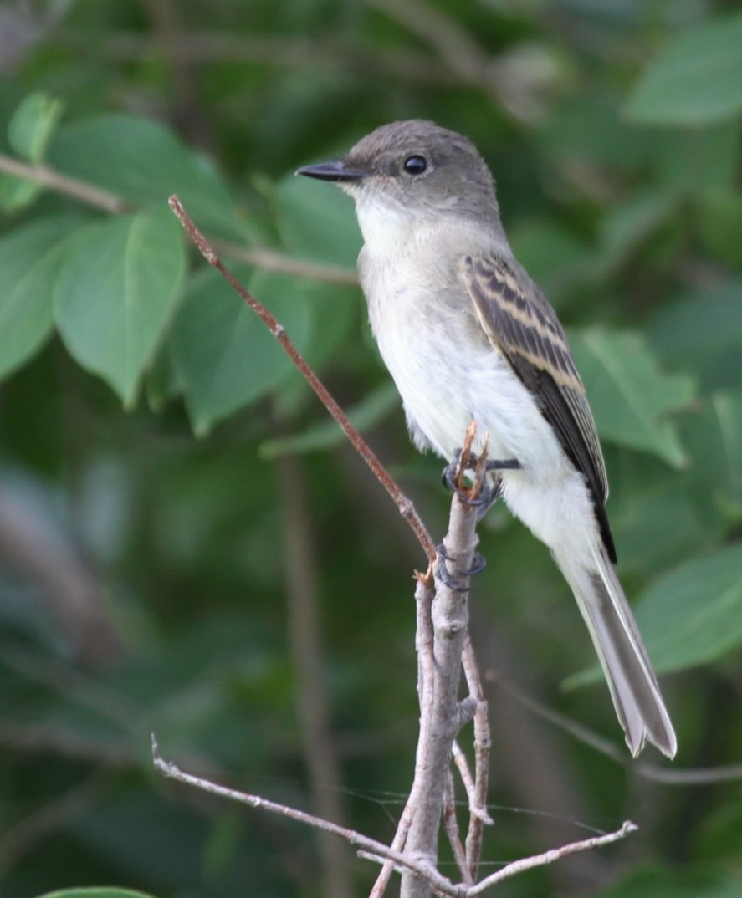
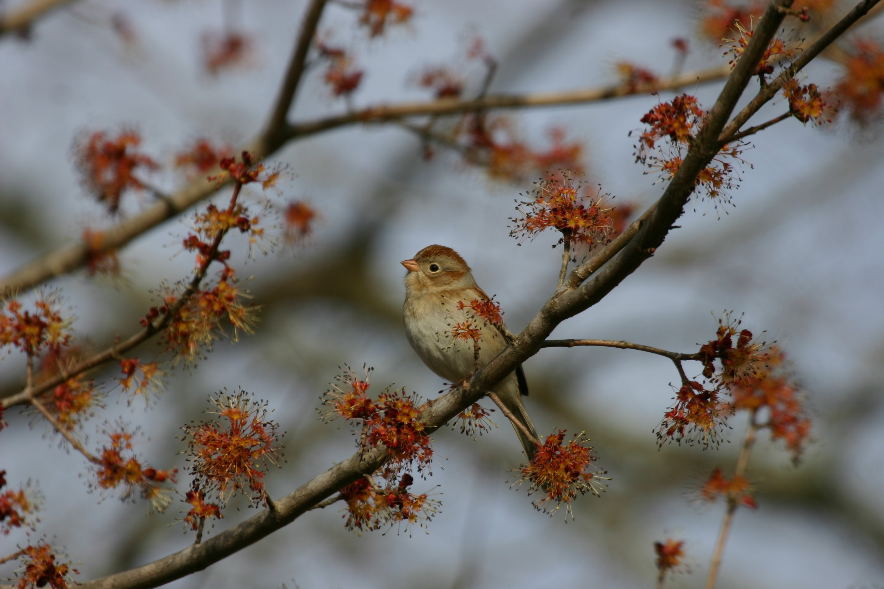
Selected Songbird SGCNs
Common Forest
Uncommon Forest
Shrubland/Early Successional Habitat

Slide 11
Predicted Relationships

Slide 12

Eastern Wood-Pewee
Forest cover at 1 km and 10 km (+)
Patch size (0; less area sensitive than others)
Distance to edge (0)
Live tree basal area and proportion oak(+)
Tree spp. richness & dead tree basal area (0)
Shrubs and ground cover (0)

Slide 13
Acadian Flycatcher
Forest cover at 1 km and 10 km (+)
Patch size (+)
Distance to edge (+)
Live tree basal area (+)
Tree spp. richness, oak proportion, & dead basal area (0)
Shrubs and ground cover (0)

Slide 14
Field Sparrow
Forest cover at 1 km and 10 km (-)
Patch size (0; not in forest)
Distance to edge (-)
Live tree basal area (-)
Other stand-scale tree metrics (0)
Shrubs and grass cover (+)
Leaf litter and green cover (0)

Slide 15
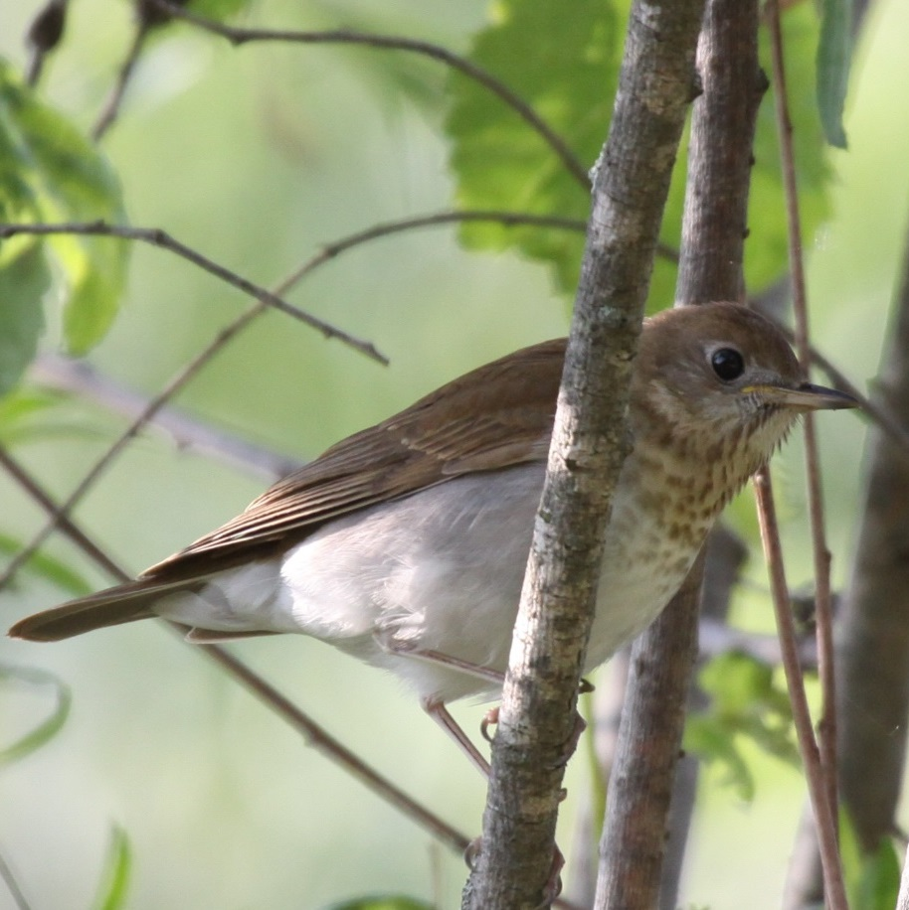
SGCN Diversity Overview
Veery
25 breeding avian SGCN detected across all four years
Top 3 most detected: Eastern Wood-Pewee, Common Yellowthroat, Field Sparrow
Top 3 least detected: Cerulean Warbler, Veery, Horned Lark

Slide 16
Selected Results

Slide 17
Eastern Wood-Pewee
Forest cover at 10 km (0)
Forest cover at 1 km (+)
Patch size (-)
Distance to edge (+)
Live tree basal area, spp. richness, proportion oak(+)
Dead tree basal area (0)
Grass cover (-)
Shrubs and other ground cover (0)

Slide 18
Eastern Wood-Pewee

Slide 19
Acadian Flycatcher
Forest cover at 10 km (+)
Forest cover at 1 km (0)
Patch size (-)
Distance to edge (+; stronger than pewee)
Live tree basal area, spp. richness, proportion oak(+)
Dead tree basal area (0)
Shrub density and grass cover (-)
Litter cover (+)
Green ground cover (0)

Slide 20
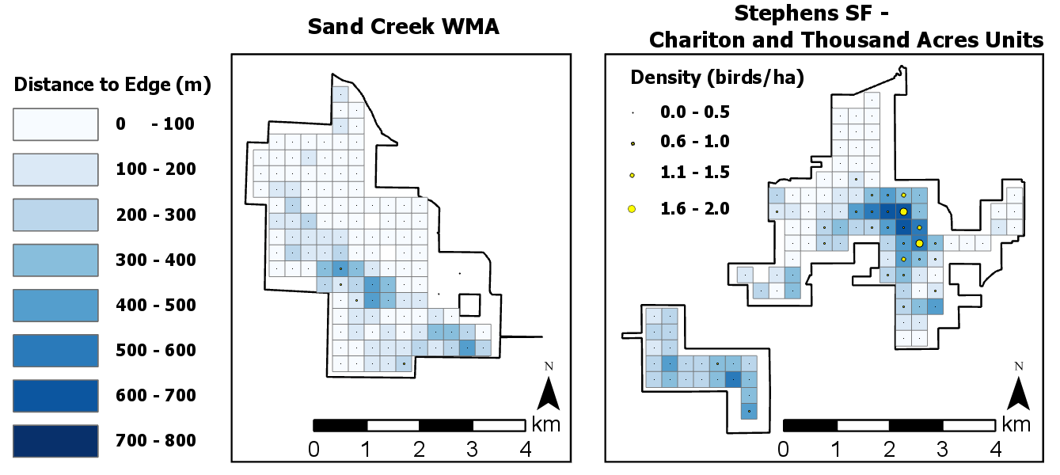
Acadian Flycatcher

Slide 21
Field Sparrow
Forest cover at 1 km and 10 km (-)
Patch size (-)
Distance to edge (-)
All stand-scale tree metrics (0)
Shrub density (+**)
Grass and litter cover (+)
Green cover (0)
**95% c.i. narrowly includes zero

Slide 22
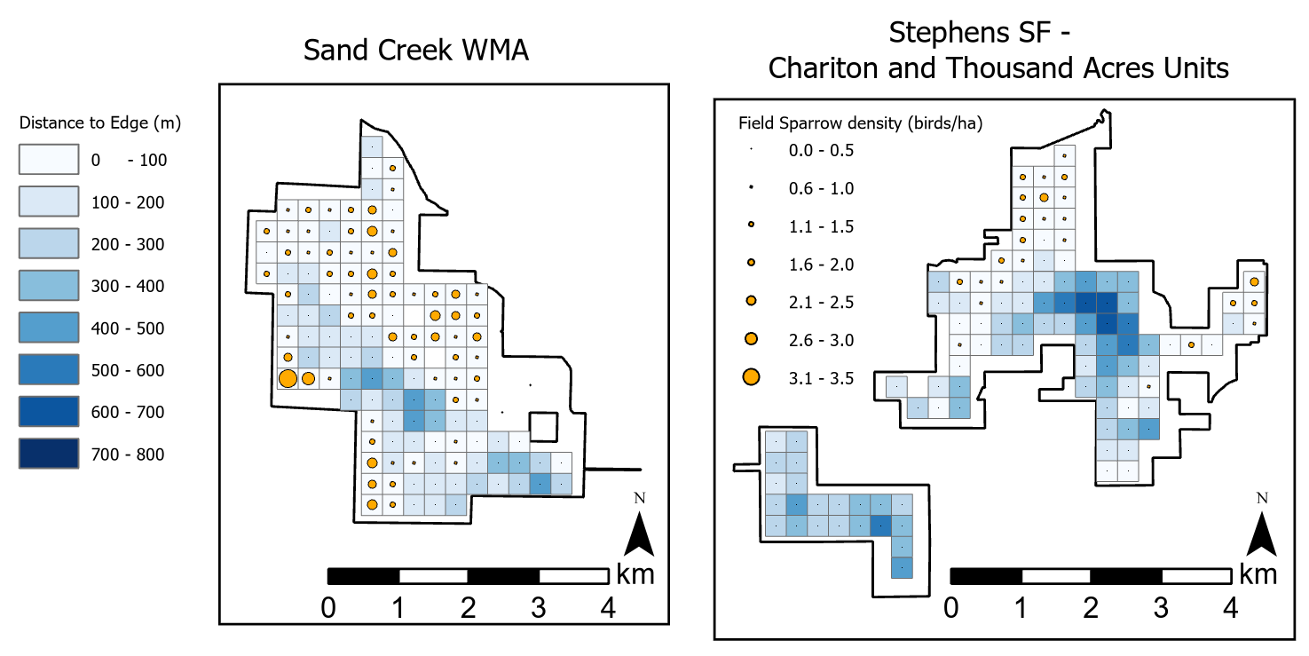
Field Sparrow

Slide 23
Discussion
Eastern Wood-Pewee:
In forests; greater density away from edges.
Associated with oak in our system.
Stronger relationship with changes at a local scale (1 km) vs larger scale.
Denser in smaller forest patches.
Acadian Flycatcher:
Mature interior forest with few shrubs and little grass (i.e., minimal disturbance); associated with oak in our system.
Patchy distribution, but denser in landscape with more forest at a broader scale (10 km).
Field Sparrow:
Grassy edges in areas with less forest at a landscape scale.
Leaf litter anomalous?

Slide 24
Discussion
Themes
Apparent tolerance for disturbed habitats (e.g., high grass/shrub, close to edge) varies.
Both landscape scale and stand-scale characteristics are important.
Caveats
Area sensitivity varies; this study is in large forest patches (1700 – 4500 ha).
Limited number of areas studied.
Plant structure > specific species.
Forest management implications
Varied management strategies are essential.
Openings (disturbance) create habitat for non-forest species.
Avian community is diverse with many conservation priority species.

Slide 25
Acknowledgements
U.S. Forest Service (USDA), Iowa Department of Natural Resources, and McIntire-Stennis Capacity Grant (USDA) for funding
Jesse Beck, Joe Cicero, Mark Edwards, Sonia Howlett, Connor Langan, Kevin T. Murphy, Jacob Newton, Rachel A. Vanausdall
Images: BCA Map from the Iowa Department of Natural Resources

Slide 26
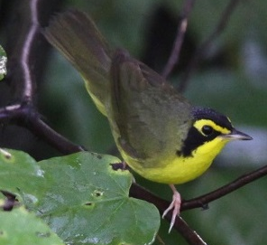
Questions?

